Slide 1
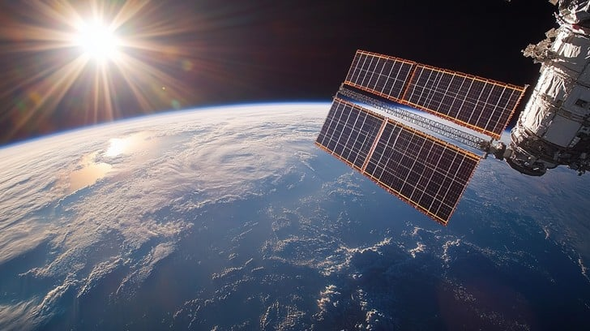
SPACE VISION 2047 AND BEYOND : THE BHARATIYA ANTARIKSH STATION
Turning Earth into a Garden, Space into our workshop.

Slide 2

THE vision
“We don’t leave the earth because it’s broken. We go to space to heal it.”

Slide 3
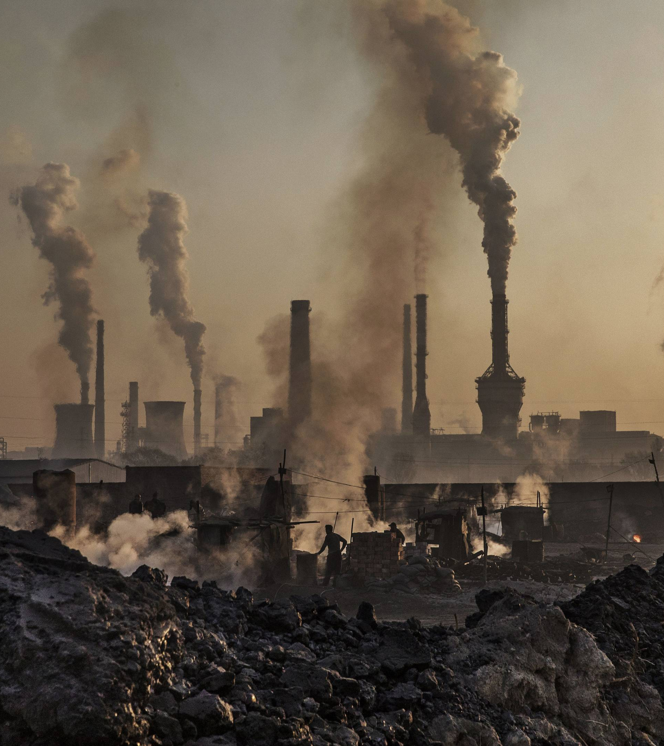
THE PROBLEM
Industrial activity on Earth Climate change, Pollution, Resource depletion.
Limited renewable energy production due to weather and land use.
Rising demand for medical breakthroughs and sustainable materials.
This Photo by Unknown Author is licensed under CC BY-SA

Slide 4
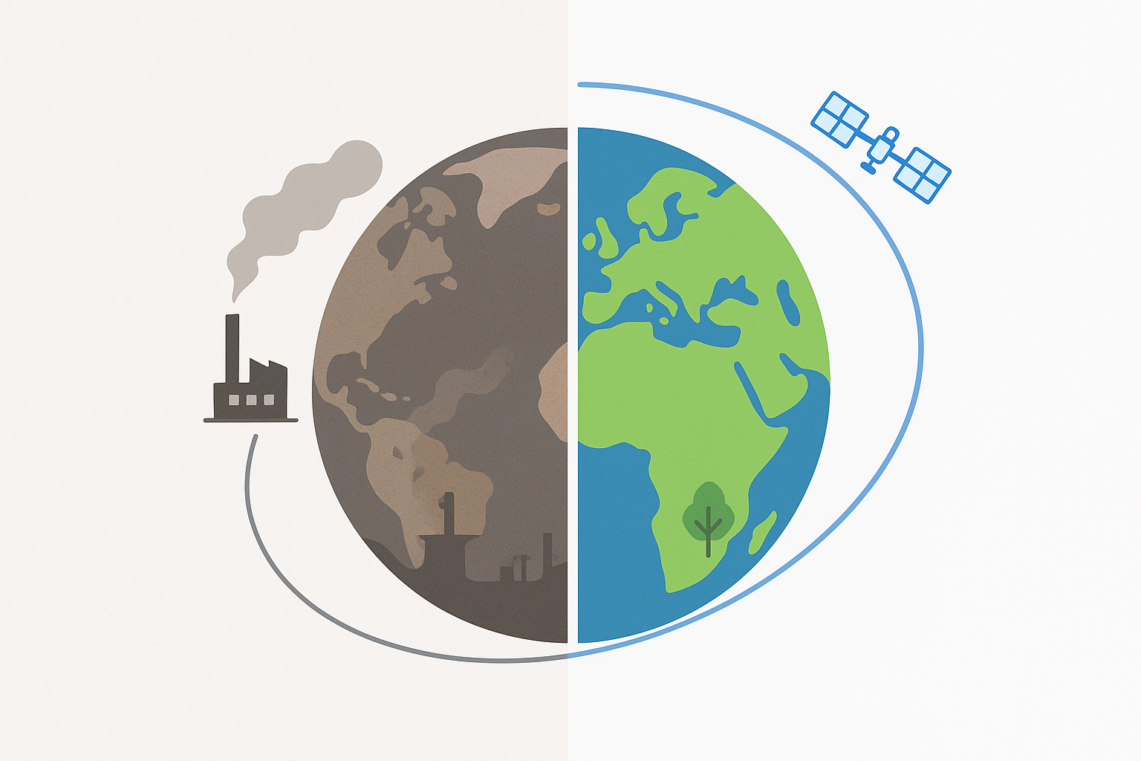
OUR SOLUTION
Key idea : Moving industry, research and energy harvesting systems into outer space.
Space-based solar power : Continuous, clean electricity for Earth.
Orbital Industries : Low to zero pollution manufacturing powered by sunlight.
Microgravity Research : Faster and effective drug development, purer materials.

Slide 5
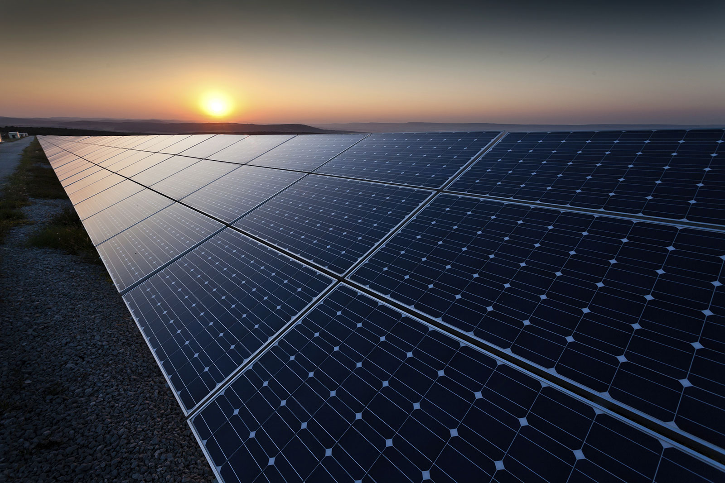
Space based solar power
Concept : Deploying a network of large solar panels in the Geostationary orbit or higher earth orbits to collect sunlight 24/7. Energy could be transported back to earth as microwaves or lasers to rectennas on earth.
This could help us to source clean, continuous renewable energy with no weather/ day-night limitations and could power entire cities.

Slide 6
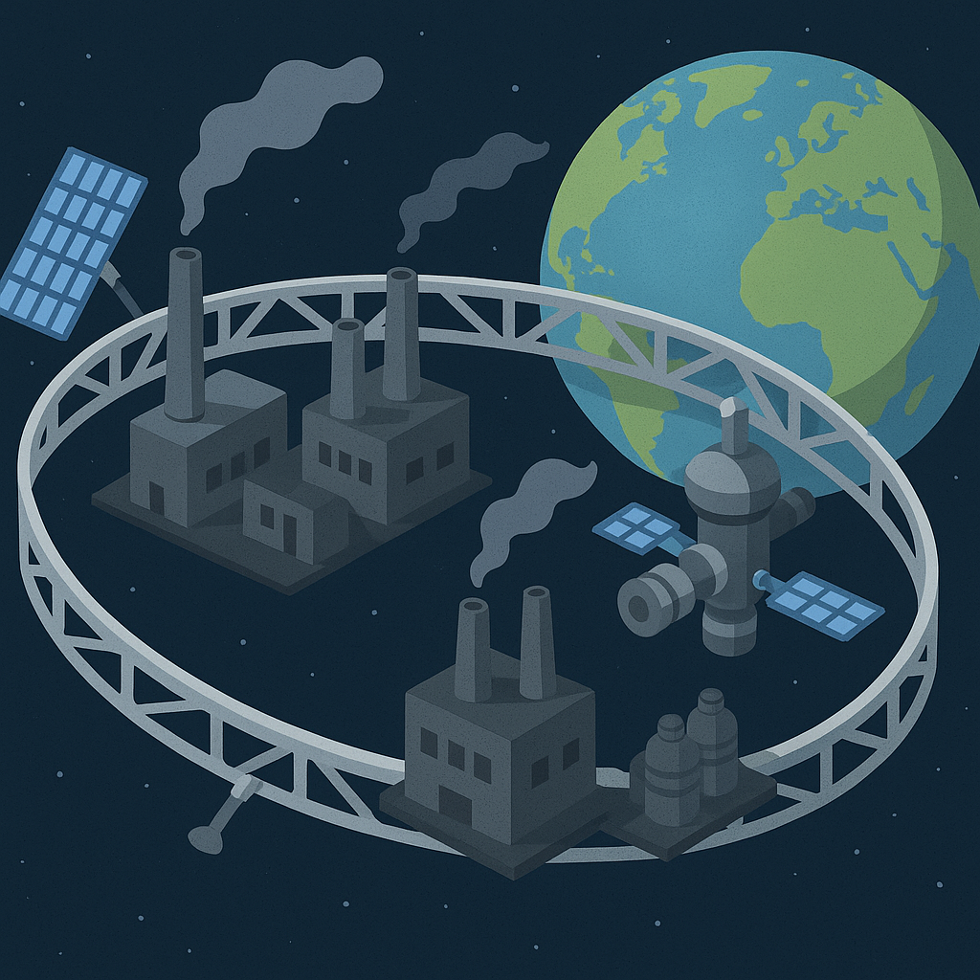
Orbital industries
Concept : Shift highly polluting or high-energy industries into orbital facilities powered by space solar arrays.
This could help us to reduce earth’s carbon footprint drastically, eliminate industrial pollution and restore ecosystems.
These industries could also operate with minimal to near zero waste because the space vaccum allows unique recycling processes.

Slide 7

MICROGRAVITY BIOTECH AND MEDICINE HUB
Concept : To potentially establish a pharmaceutical research module where microgravity enables :
Better protein crystallization for drug design.
Cultivation of organoids for transplant research.
Production of purer biological compounds.
This could help in faster drug discovery, more effective vaccines, and advanced cancer therapies.

Slide 8
Space based solar power
CHALLENGES
POSSIBLE REMEDIES
Microwave/Laser Transmission Risks – Potential interference with satellites, aircraft, and biological life. Efficiency drop in long-distance power beaming. Solar flares or cosmic rays could damage solar arrays
Use narrow, targeted beams with auto shut-off if alignment drifts. Select safe frequency bands to minimize biological impact. Apply radiation-hardened materials and AI-driven solar flare prediction for preventive shutdowns.

Slide 9
Orbital industries
CHALLENGES
POSSIBLE REMEDIES
Space Debris Impact – Risk of collisions with operational facilities. High Launch & Construction Costs – Transporting heavy machinery into orbit. Worker Safety – Exposure to microgravity and radiation.
Implement active debris removal systems and debris-tracking AI. Use modular, in-orbit assembly and materials from asteroid mining. Provide magnetic/radiation shielding and artificial gravity modules for crew.

Slide 10
Microgravity research
CHALLENGES
POSSIBLE REMEDIES
Sample Contamination – Maintaining sterile, controlled environments in space. Return Logistics – Bringing delicate or time-sensitive research back to Earth intact. Cost & Scalability – Limited access to lab facilities in orbit.
Utilize sealed, autonomous lab pods with robotic handling. Develop gentle re-entry capsules with shock-absorption and thermal shielding. Expand capacity using AI-driven remote experimentation and shared multi-nation facilities.

Slide 11
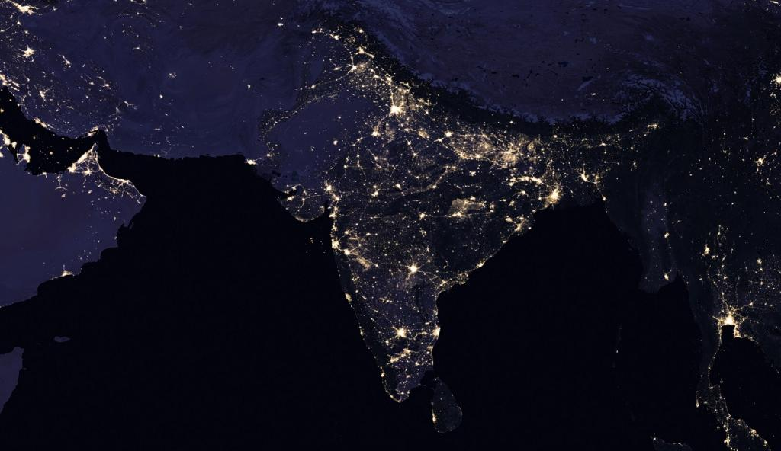
Benefits to earth and india
Environmental : CO2 reduction, smog-free cities, restored ecosystems.
Economic : New industries and high-skill jobs.
Social : Energy for rural areas, faster medical cures, food security.

Slide 12

Thank you
George Thobias Manoj
Vyshnav Narayanan C V
Mohamed Zayan N A

